Slide 1
Planning & writing Business messages
A.S.Fathima Shifara
Visiting Lecturer
Ati-sammanthurai
2022-10-18

Slide 2
What is a business message
Business messaging is the way brands initiate and respond to customers over various messaging channels. It empowers customers to reach out to brands and brands to reach out to customers. Examples of business message include:
SMS/MMS
Web-chat
Facebook Messenger
WhatsApp
Social media direct messages (DMs)

Slide 3
Benefits of business messaging
Engage with more customers: Businesses that offer more channels don't alienate customers with preferred messaging needs.
Provide real-time conversations: Customers don't want to wait days for a response—they often need help immediately. Engage with them faster with instant messaging to provide a more positive experience. Sometimes, they just have a question about sizing or even a product's color—answer quickly to seal the deal before they visit another site instead.
Handle more conversations: Businesses can only talk with one person on the phone at a time (effectively). With messaging, you can have several conversations simultaneously without hurting customer engagement or the customer experience.
Elevate customer satisfaction: Customers will be happier when they get to use the channels they want and can achieve a faster resolution.
Use video and images: Business messaging (unlike with a phone call) lets you send Multimedia Messaging Service (MMS) texts with pictures, emojis, GIFs, and videos. Send your customers pictures of relevant products or give them a quick walk-through with a video tutorial. Customers can also use file sharing to upload their own screenshots and pictures.

Slide 4
9 examples of business messaging
Here are a few examples of ways you can use business messaging:
Welcome - Send new customers or subscribers a welcome message. This sets the stage for future messaging, rolls out the red carpet, and provides them with opt-out details.
Promotional - Give your customers discount codes and exclusive offers. Make these offers enticing to encourage your users to check their messaging applications or text messages.
Confirmation - Let your customers know when you receive their order or when you're confirming an appointment.
Reminder - Message your customers about upcoming appointment reminders.

Slide 5
5. Customer service - Chat with your customers in messaging applications to solve their problems. This gives you better access to screenshots, videos, images, and links.
6. Shipping notification - Notify your customers when an order has shipped and provide them with ongoing updates until it arrives.
7. Security alert - Message your customers immediately if there is any suspicious account behavior or any emergency.
8. Verification - Use messaging to send one-time passwords for user verification.
9. Conversations - Chat with your customers. This could be a sales representative walking customers through pricing options or a customer service agent answering questions about sizing. It could even be two agents talking with a single customer or, one agent speaking with two customers.

Slide 6
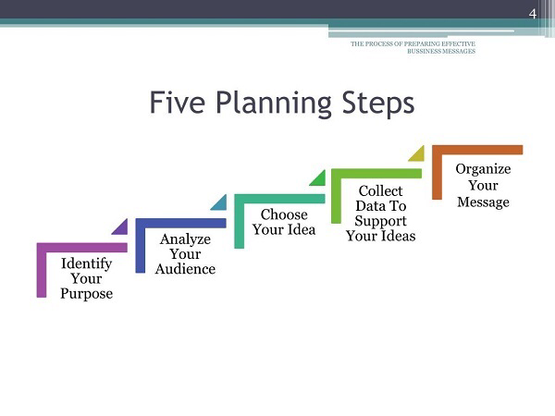
Planning a Business Message

Slide 7
Identify your Purpose
The first of the five planning steps of a message is to have a clear idea of its purpose. Normally, the purpose of the message is two-fold: the reason for the message itself and the creation of goodwill.
The first step when planning a message is to determine its specific purpose. Your message may be informational, such as announcing your firm’s new address. It may be persuasive, such as asking the customer to buy a particular product.
Besides, all messages have an underlying purpose to create goodwill. Courtesy and consideration are especially necessary to create goodwill. Consequently, if the purpose is not clear in the mind of the sender, the communication will fail to achieve the desired feedback.

Slide 8
Analyze your Audience
Seeing the message from the receivers’ point of view, and keeping in mind, the needs, interests, attitudes, and culture, help to analyze the audience. You can imagine the audience or reader if you know them. Much of your writing, however, will go to people or companies you have never met. So be careful with the salutation of the message. Pay attention to the proper placement of first and last names and correct titles.

Slide 9
Choose your ideas
You have to choose the ideas for your message which is the third step for planning a business message. Thus, if you are answering a letter, underline the main points to discuss, and jot down your ideas in the margin.
Likewise, if you are writing an uninvited or a complex message, begin by listing ideas and then choose the best ideas for your receiver. However, the ideas you include depend on the type of message you are sending, and the background and location of your receiver (national or international).

Slide 10
For example, in a reply from a large resort hotel to a person who has asked about rates, you might send a brief list of in- and out-of-season prices.
But if you will limit your response to this list, you would miss an opportunity to sell the other services you have to offer. Include the following ideas in such kind of response:
A. First, thank the reader for the letter, asking about rates.
B. Then, mention the services the hotel provides.
C. Similarly, Include information about the place where the hotel is located.
D. Then, Give details about the facilities you offer.
E. Finally, list the rates.
You might also include a brochure of your hotel along with small brochures of famous sights in your area.

Slide 11
Collect data to support your ideas
You must determine whether you need specific facts, figures, or other forms of evidence to support your points. Moreover, be sure you know your company policies, procedures, and product details if your message requires them. Also, check your data on the names of individuals, dates, addresses, etc. Similarly, you may sometimes need to enclose a brochure, table, picture, or product sample. Lastly, be sure to collect enough data to support your ideas.

Slide 12
Organize your message
This is the last of the five steps for planning a business message. Before you write your first draft, outline your message (mentally or on paper).
Choose your organizational plan after you have worked through your basic five planning steps for planning a business message.

Slide 13
Approaches of message communication
Direct (deductive) Approach
Indirect (inductive) Approach

Slide 14
Direct (deductive) Approach
When your reader or listener will have a favorable or neutral reaction to your message, use the direct approach.
Begin with the main idea. After the opening, include all necessary details and end with an appropriate, friendly closing.

Slide 15
Indirect (inductive) Approach
When your reader or listener might react negatively to your message, you should not present the main idea in the first paragraph.
Begin with a buffer, give an explanation and then introduce the main idea.

Slide 16
BEGINNINGS & ENDINGS
“First impressions are lasting”
“We remember best what we read last”

Slide 17
BEGINNINGS
The opening of a message determines whether the reader continues reading, puts the message aside or discards it.
Choose openings appropriate for message purpose and reader.
Make the openings considerate, courteous concise, clear.
Check for completeness.

Slide 18
ENDINGS
Closing should be strong, clear & polite. They should leave a sense of closure & goodwill with the receiver.
Make action request clear and complete with 5 W’s and the H.
End on a polite, courteous thought.
Keep last paragraph concise and correct

Slide 19
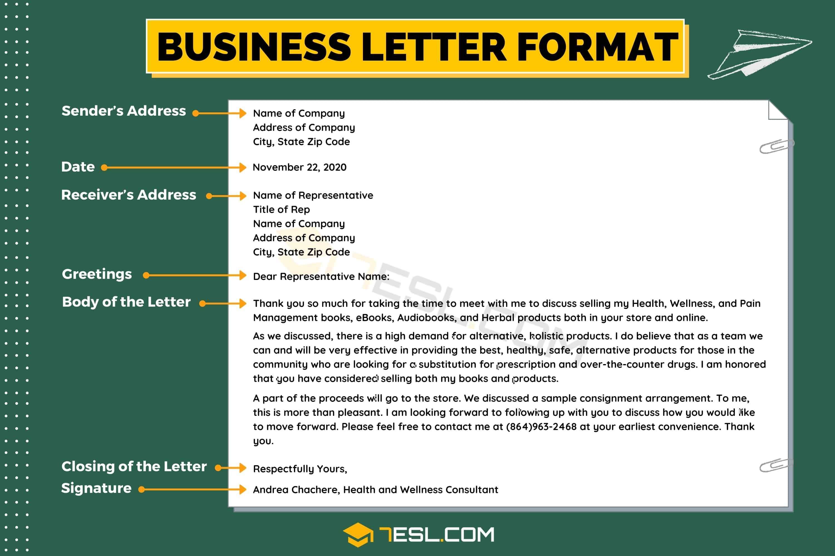

Slide 20
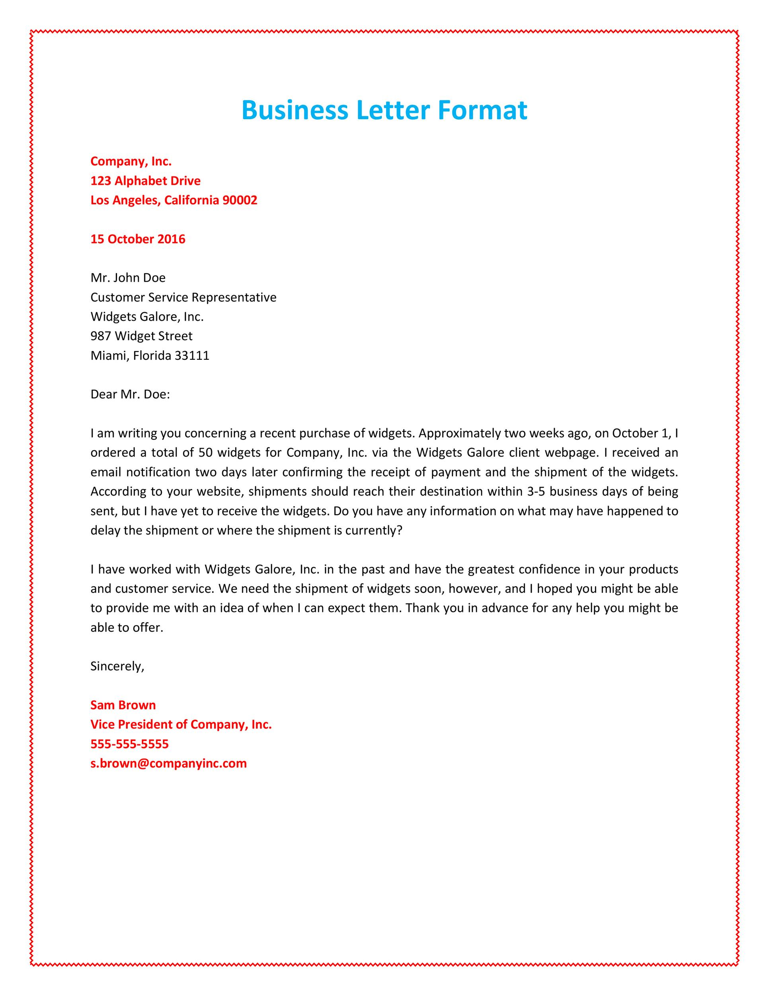

Slide 21
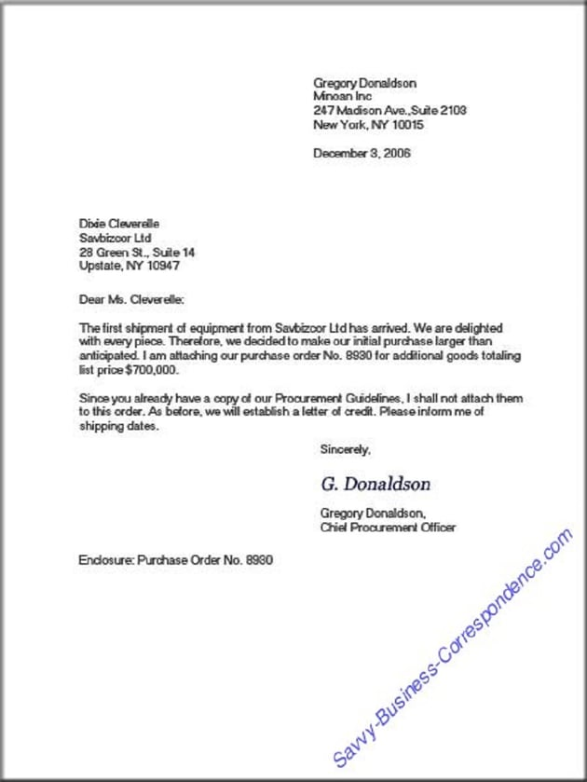

Slide 22
Thank you

